Slide 1
Welcome
To our presentation About
Online Education Website Project

Slide 2
Online Education Website
Let’s introduce our team
Group No: 18
Team members
Safwan Ishrak (ASH2001029M)
Md. Kutub Uddin Abir (MUH2001009M)
Farman Arefin Tamim (ASH2001043M)

Slide 3
Introduction about the project
With roles for administrators, teachers, and students, our online education platform simplifies the learning process. Admins manage users, log trails, and system data. Teachers create classes, upload materials, and communicate. Students sign up, engage with quizzes, download materials, and connect with peers and teachers, fostering a collaborative and efficient virtual learning environment.

Slide 4
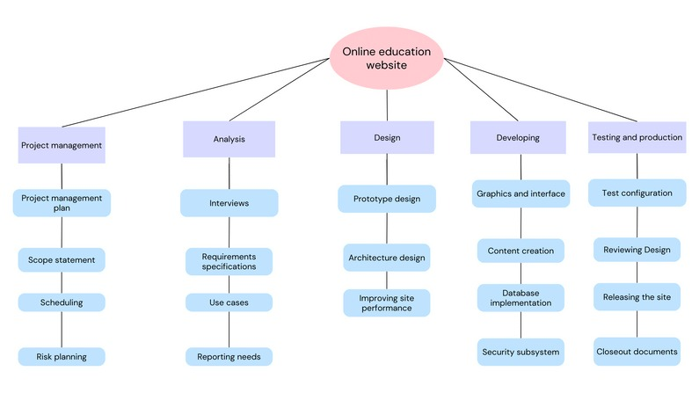
Planning and Requirement Analysis
Planning
Work Breakdown Structure (WBS) :

Slide 5
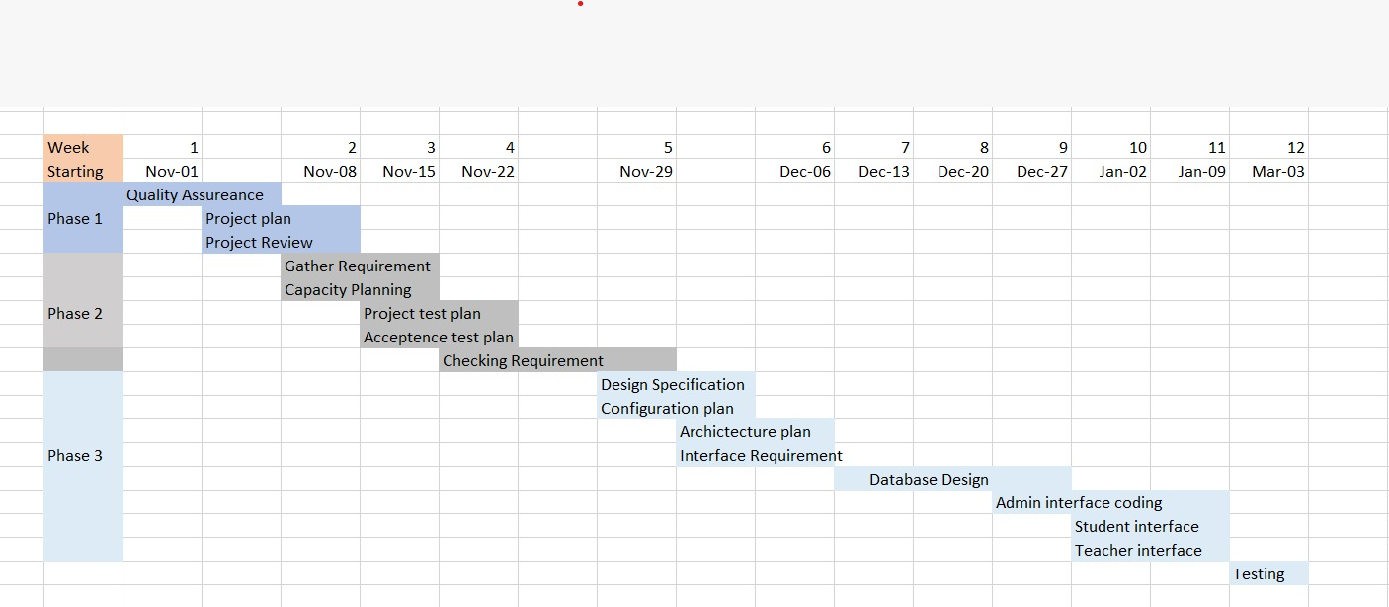
Project Scheduling

Slide 6
RMMM Plan
Risk management technique is usually in the software Project plan can be divided into Risk Mitigation, Monitoring and Management Plan(RMMM).
Risk Mitigation:
Communicating with concerned member to find off probable risk.
Removing all causes that are the reason for risk creation.
Controlling the corresponding documents from time to time.
Conducting timely reviews to speed up the work.
Risk Monitoring:
Checking the predicted risk occur or not.
Ensuring proper application of risk avoidance are applied or not.
Gathering information for future risk assessments.
Risk Management:
Project not completed within deadline then negotiate with customers.
Ask some extra time or give some additional features etc.

Slide 7
ii. Define Project Scope :
iii. Set objectives and goals:
Objective: Develop PHP , MySQL-based online education platform.
Admin:
Manage student/teacher info, subjects, and logs.
Monitor user activity and login logs.
Teacher:
Create/manage classes, upload materials, and administer quizzes.
Grade assignments, post announcements, manage events.
Message co-teachers and students.
Student:
Sign up, access materials, view classmates.
Take quizzes, view evaluations, message peers/teachers.
Objective: Develop an efficient online education platform using PHP.
Goals:
Admin: Manage student/teacher info, subjects, and user logs.
Teacher: Create/manage classes, upload materials, grade assignments.
Student: Sign up, access class materials, interact with peers/teachers.
Overall Goal: Create a user-friendly online learning platform.

Slide 8
iv. Resource Planning:
a. Project Estimation for Online Education Website
Estimate project duration considering development, testing, and deployment phases.
Ensure efficient resource allocation for tasks such as adding, editing, and deleting student/teacher information.
b. Software cost estimation
Assess software development costs, including PHP programming, database setup, and frontend design.
Estimate project budget accurately by considering the complexity of features like class creation, material upload, and quiz creation.

Slide 9
Defining Requirement
Defining Requirements:
Admin: Enable CRUD operations for student and teacher data, manage academic entries, and monitor user activity.
Teacher: Facilitate class creation, material management, assessment creation, announcement posting, and communication.
Student: Allow registration, access to class content, participation in assessments, and communication with peers and teachers.

Slide 10
ii. Functional Requirement
iii. Non-functional Requirement
iv. Requirement Reviews and Approved
Admin: Manage student/teacher info and academic entries, track user activity.
Teacher: Create/manage classes, upload materials, assess students, and communicate.
Student: Access materials, participate in assessments, and communicate with peers/teachers.
Security: Ensure data protection and secure user authentication.
Performance: Maintain fast system response times for a smooth user experience.
Usability: Offer a user-friendly interface for convenient access and navigation.
Conduct regular reviews to ensure requirements alignment.
Document and track approved requirements throughout the project.

Slide 11
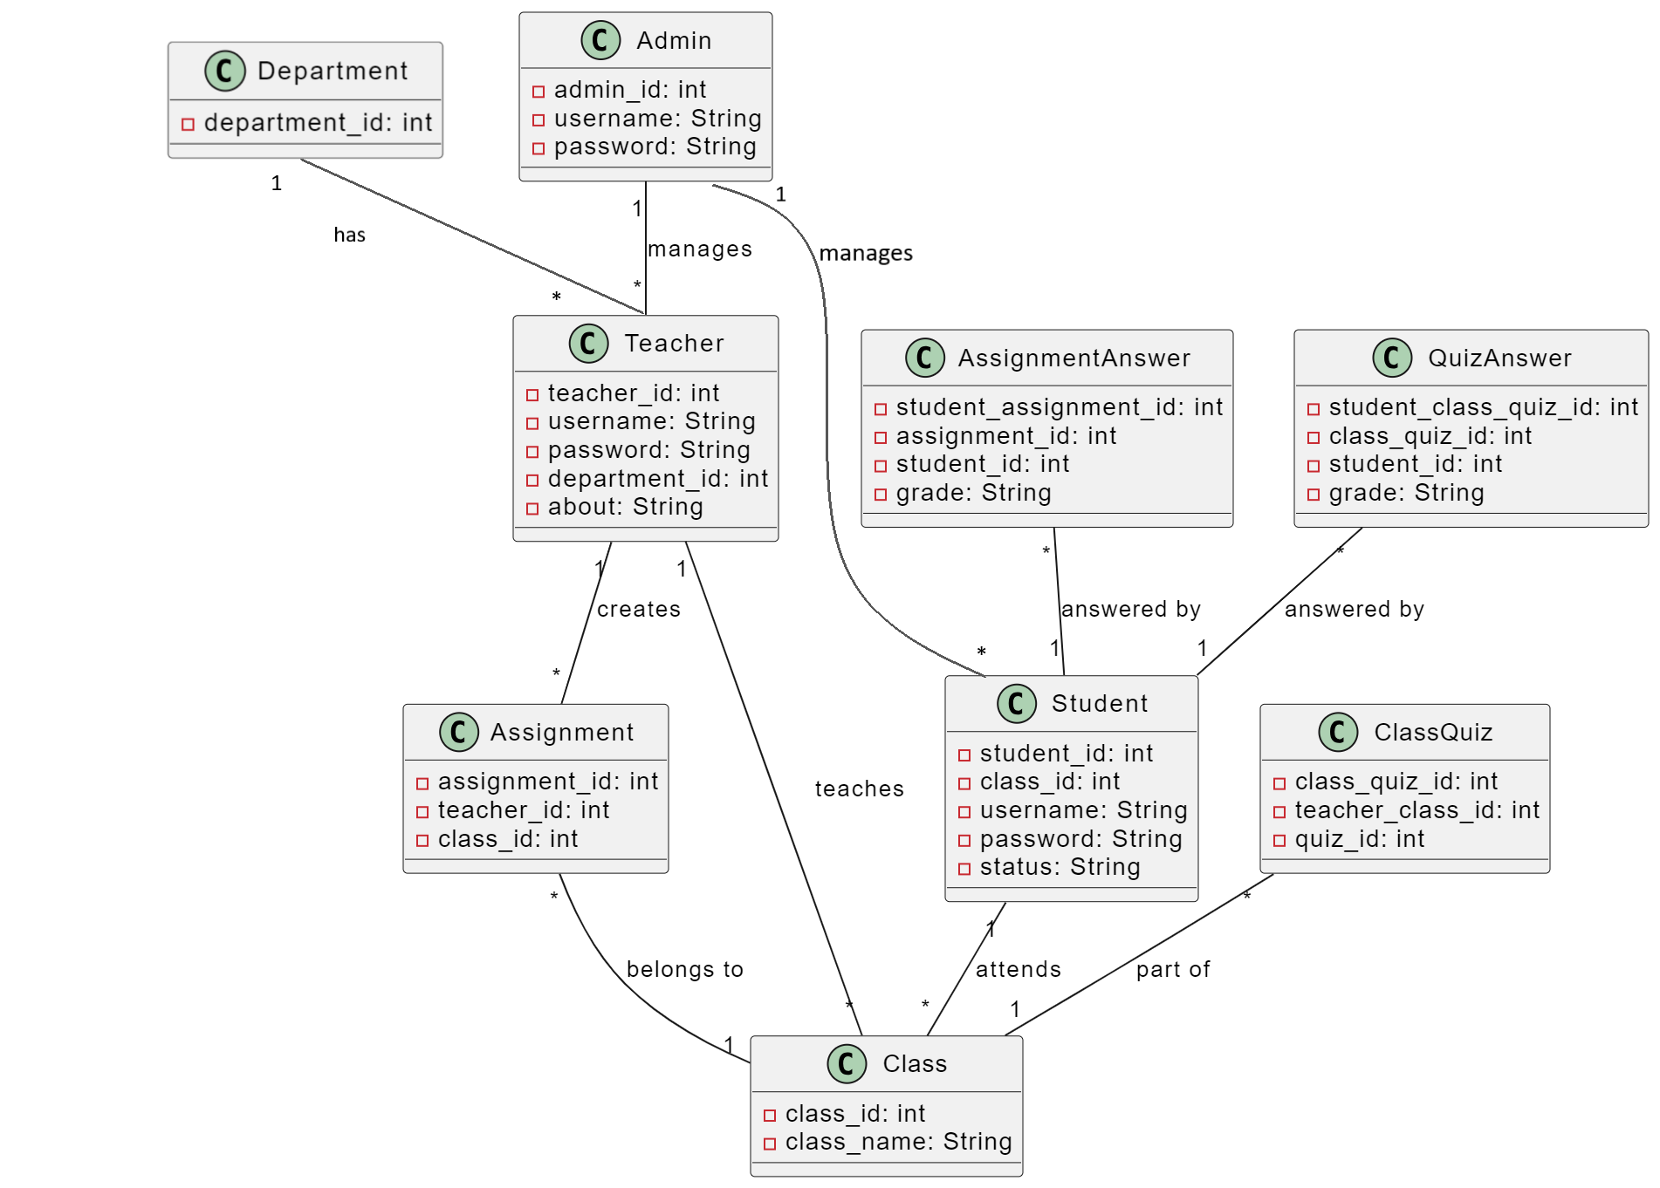
Design
Class Diagram:

Slide 12
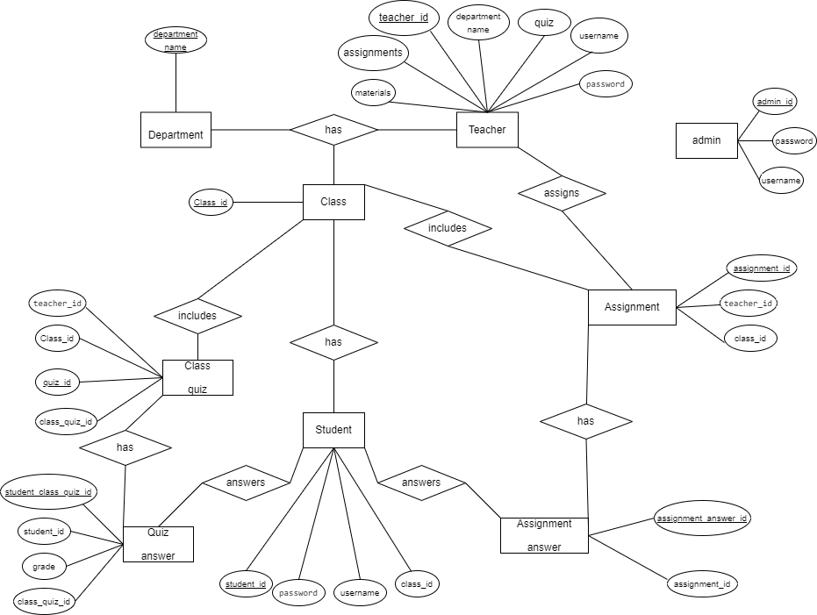
ER Diagram:

Slide 13
DFD
Input/Output
Function
Flow
File / Database

Slide 14
Level 0 DFD
Admin
Record Analysis
Record Analysis
Teacher Signup
Student Signup
Online Education
Website
Student Login
Teacher Login
Teacher
Student
Student Logout
Teacher Logout
Class Details
Grade Submission

Slide 15
Level 1 DFD
All Records
Student info
Online Education Website
Student info
Database
Student
Verify Document
Student enrollment
Add/Update/Delete
Admin
Providing Student id
Course Manage-ment
Add/Update/Delete
Assignment and Quiz managemnt
Update course
details
Teacher

Slide 16
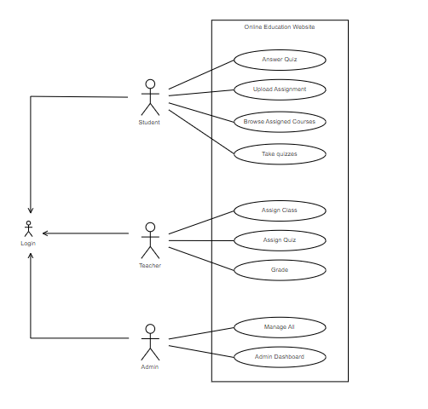
Low Level Architecture

Slide 17





High Level Architecture
Server
Databases Cluster
Client

Slide 18
Development Of The Software
Some Screenshots

Slide 19
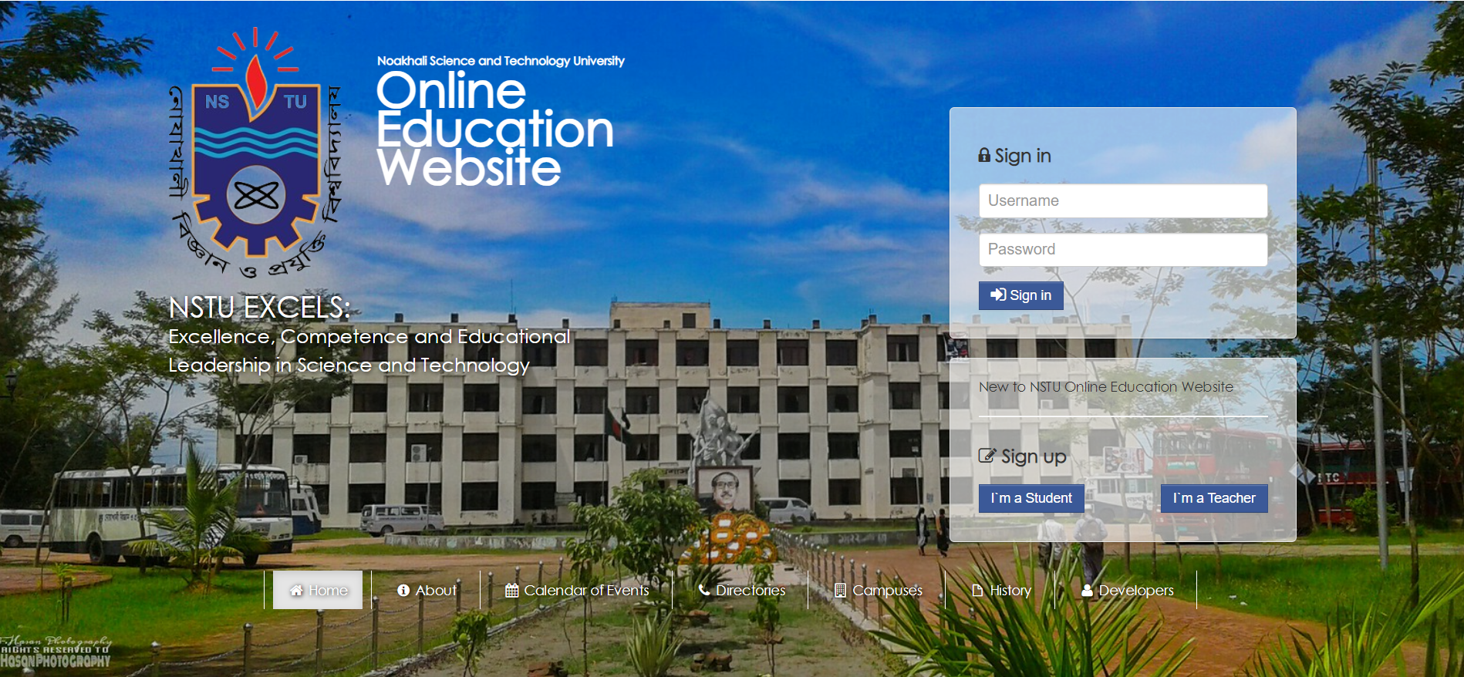
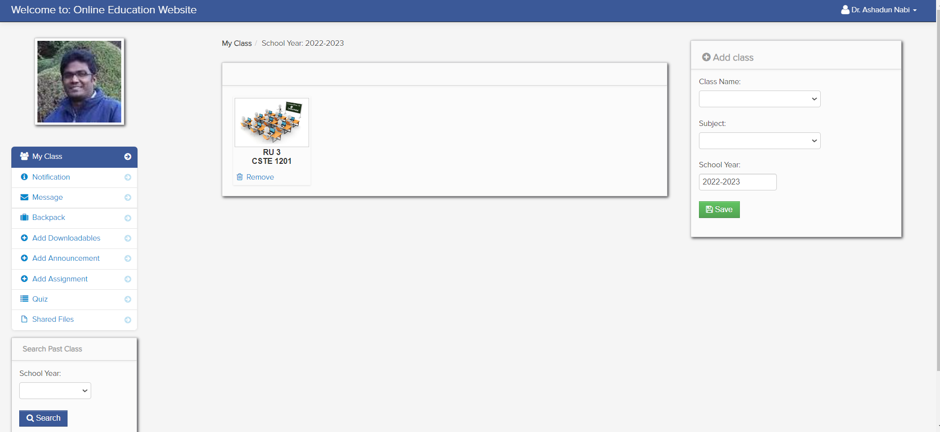
Home Page
Teacher’s Profile

Slide 20
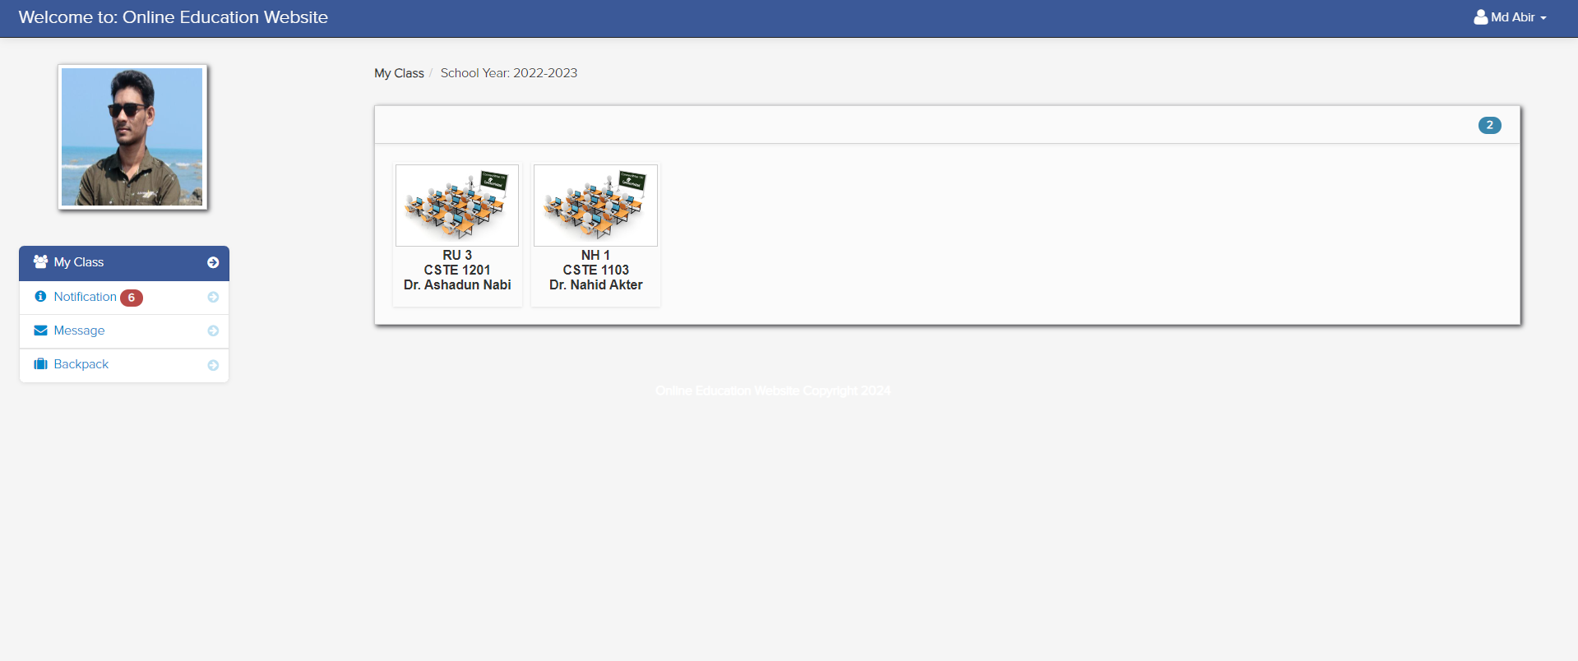
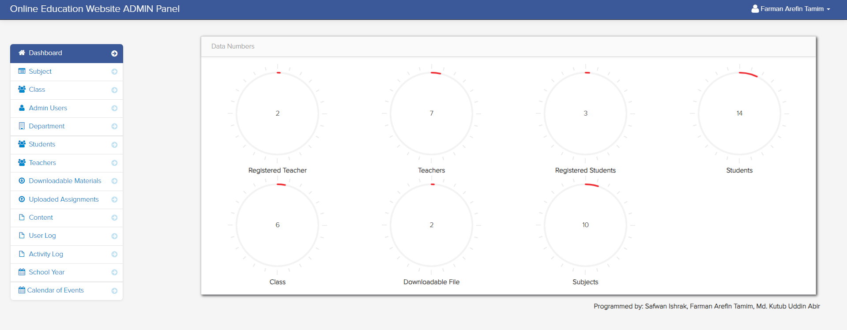
Student’s Profile
Admin Dashboard

Slide 21
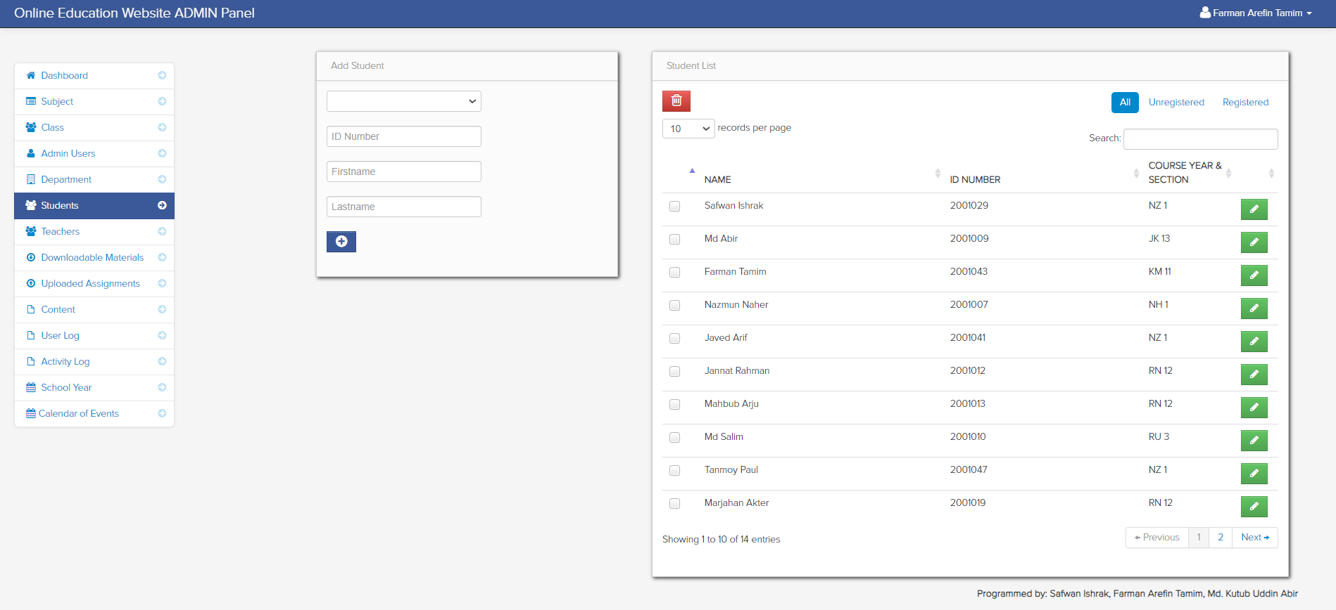
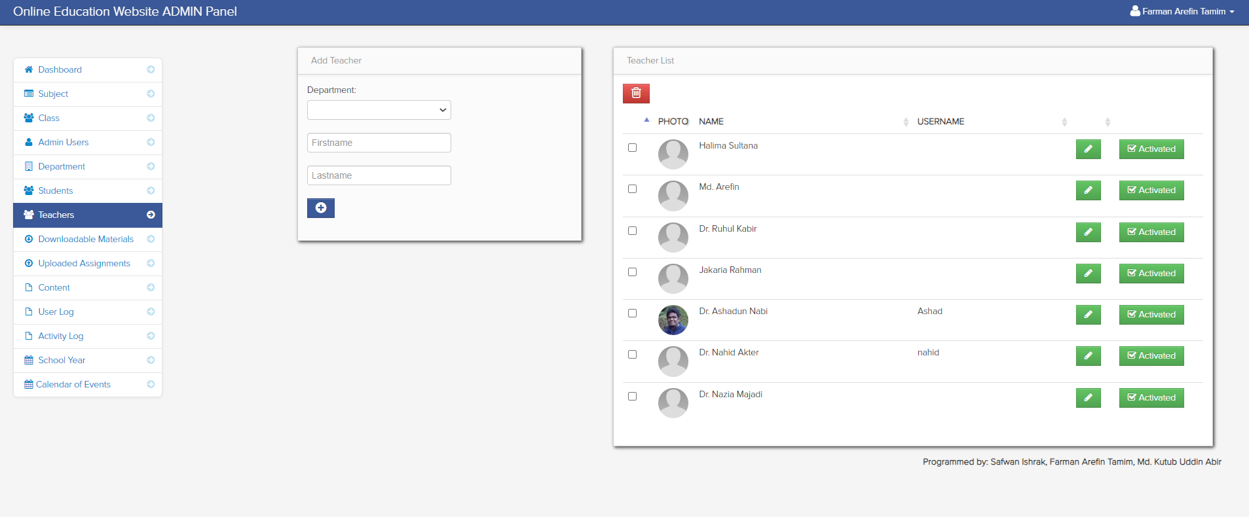
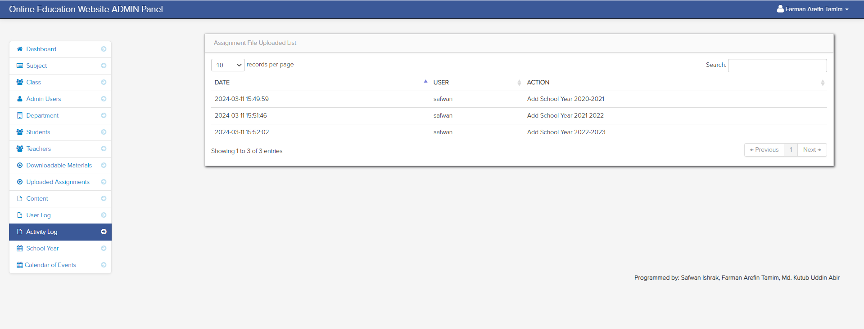
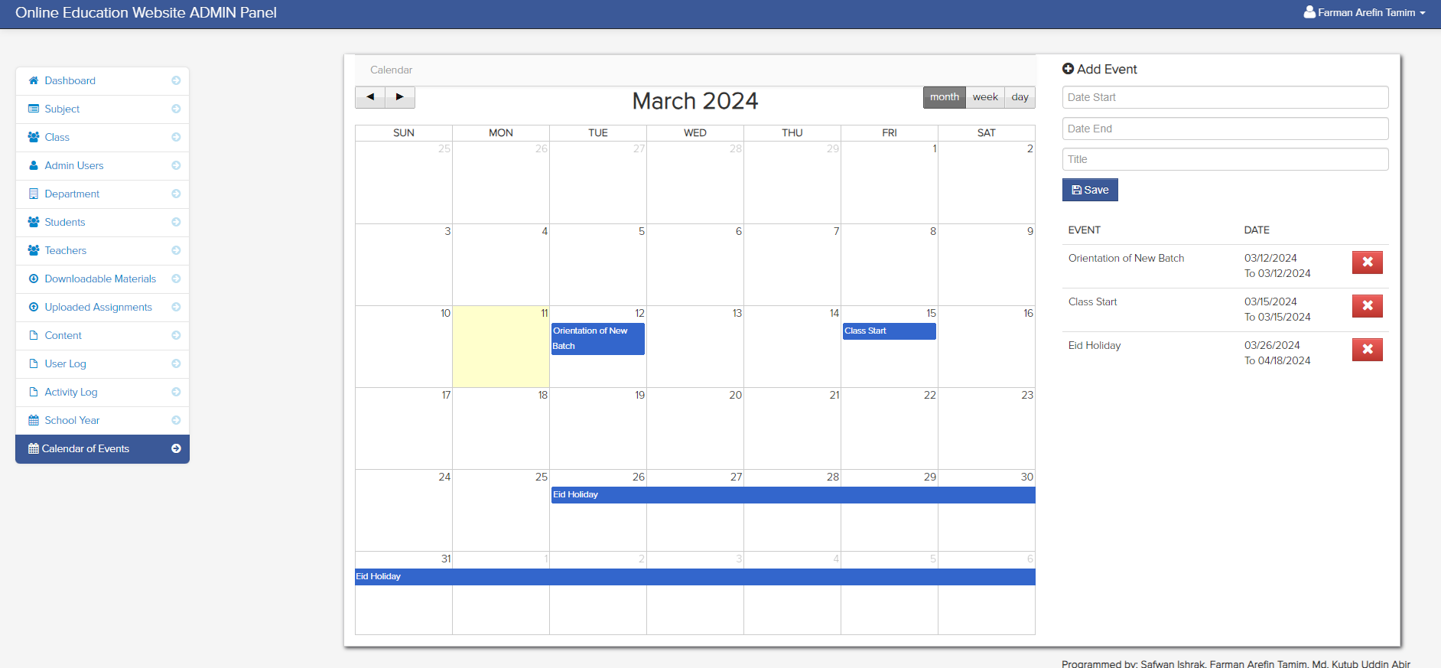
Student’s List Update
Teacher’s List Update
Activity Log
Calendar of Events

Slide 22
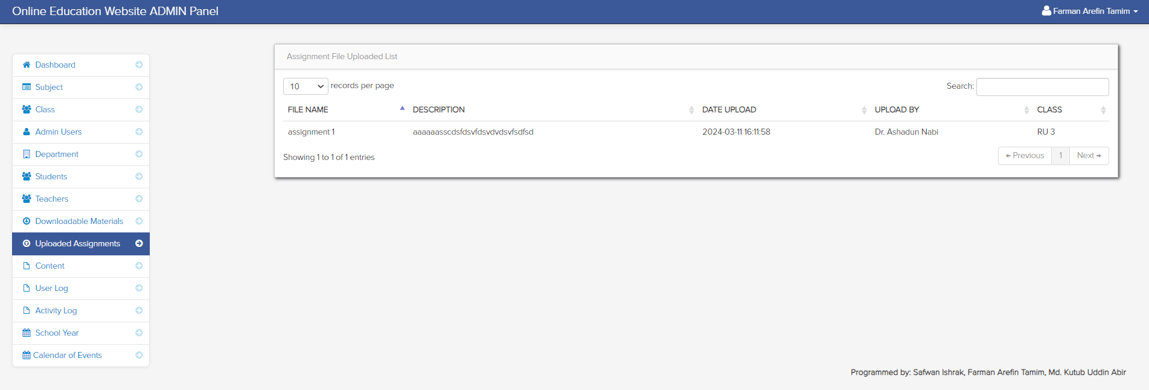
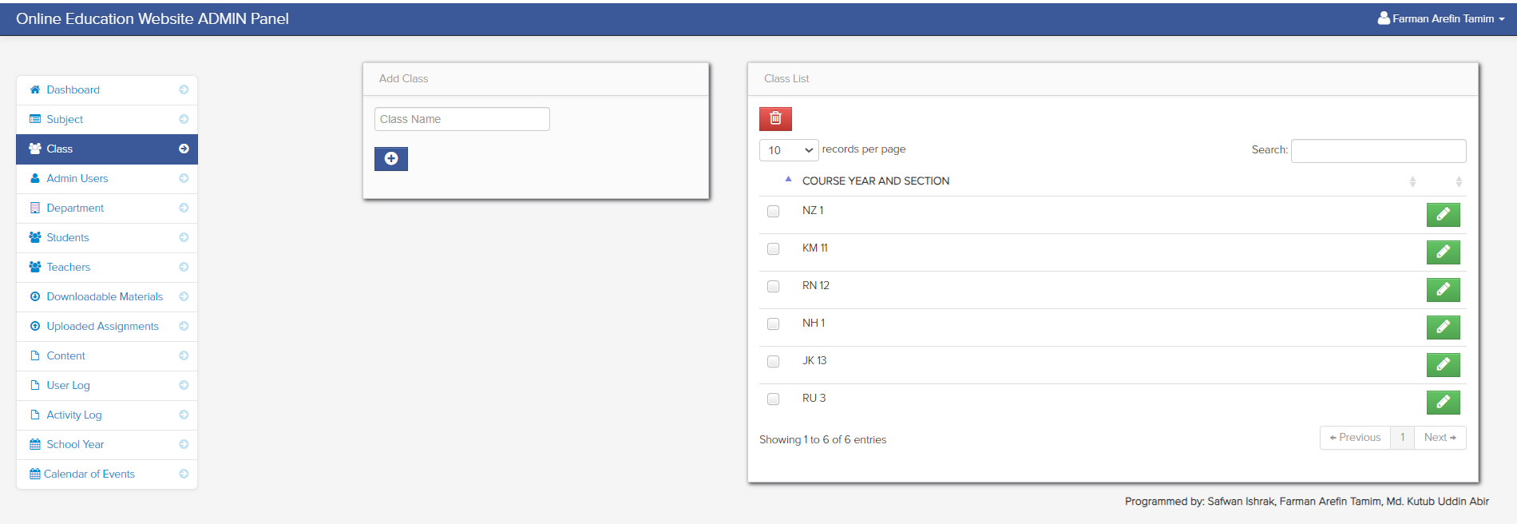
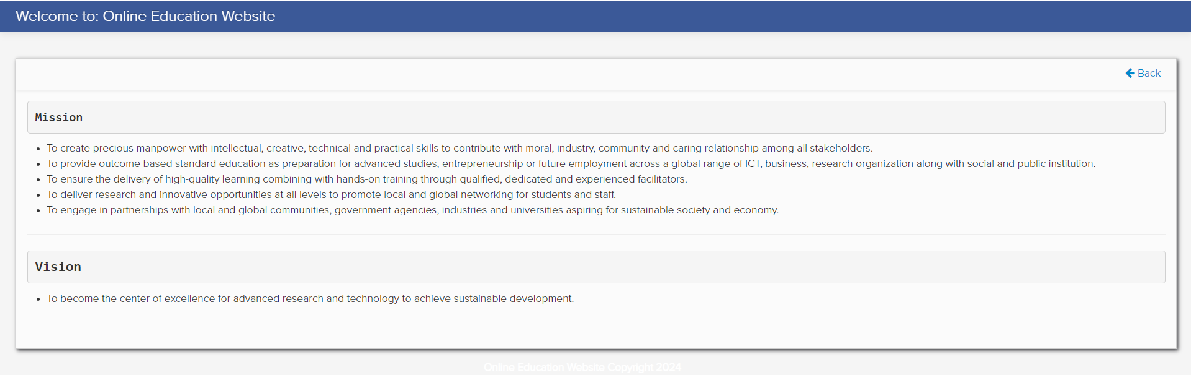
Uploaded Assignment
Class
Mission And Vision

Slide 23
Product Testing and Integration
Black-box Testing for Online Education System
Unit Testing:
Verify individual components such as adding, editing, and deleting student/teacher information.
Test subject, class, and school calendar entry functionalities independently to ensure correctness.
System Testing:
Evaluate the overall system functionality including user login, user activity tracking, and log viewing.
Test the interaction between different modules like class creation, material upload, and announcement posting.
Integration Testing:
Verify the integration of various components such as message functionalities, class creation, and student/teacher management.
Test the interaction between different user roles, ensuring seamless communication and data flow.

Slide 24
White-box Testing for Online Education System
Admin Functionality Testing:
Test the functionality of adding, editing, and deleting student/teacher information.
Verify the accuracy of subject, class, and school calendar entry processes.
User Activity Tracking Testing:
Ensure the login trail of every user is accurately recorded.
Validate the functionality to view logs of every user activity.
Teacher User Testing:
Verify class creation functionality, including adding students and managing class details.
Test the upload and download functionality of downloadable materials.
Ensure the creation and grading of practice quizzes and assignments.
Validate the posting of announcements and the creation of class calendar events.
Test the functionality to message co-teachers or students.
Student User Testing:
Validate the sign-up process for student accounts.
Test the functionality to view classmates in the same class.
Ensure the ability to answer practice quizzes and view assignment and quiz evaluations.
Verify the download and upload functionality of materials.
Test the ability to message teachers or classmates.

Slide 25
Conclusion
"Our team has taken a creative and collaborative journey throughout this project. We've worked tirelessly to develop an online education platform that empowers students, teachers, and administrators. Every move we have made, from developing user-friendly interfaces to adding reliable functionality, has been influenced by our dedication to quality and love of learning. As we come to an end, we're happy with the work we've done and enthusiastic about the beneficial influence our platform will have on the future of learning. Thank you for joining us on this journey."

Slide 26
THANK YOU

